Slide 1
R Clinic
Session 7
Introduction to mixed effect models

Slide 2
R Clinic
Helping R users and learners with error messages and problematic code
Snippets sessions
‘Jumping off point’ for new methods
Refresher
Possibilities in R
R books available

Slide 3
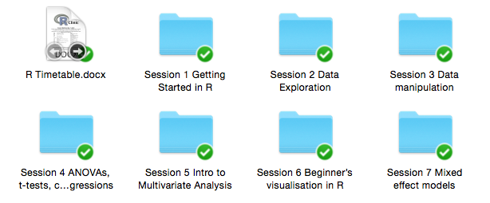
Snippets session
Code and slides added to Dropbox at the beginning of sessions

Slide 4
Upcoming snippets
Understanding model outputs 8th July
R for spatial data introduction 15th July
Further data visualisation 22nd July
Writing a function 29th July
Creating loops, and apply functions 5th August
Phylogenetics in R 12th August

Slide 5
Feedback
Happy to accommodate requests wherever possible
Survey Monkey
Email
In person

Slide 6
Refresher: linear regression
lm()
y ~ x1 * x2 * x3
y ~ x1 + x2 + x3 + x1:x2 + x1:x3 + x2:x3 + x1:x2:x3
e.g. using iris data set
model simplification - stepwise
We'll keep it simple for now - no interactions!!

Slide 7
Model simplification
Remove interactions first
Compare models - R2, anova(mod1, mod2)
Remove non-significant variable
Compare models - R2, anova(mod1, mod2)

Slide 8
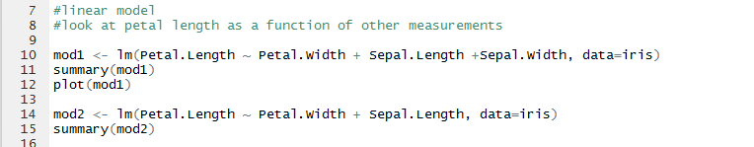
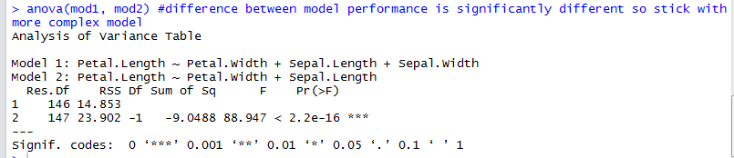
Stepwise simplification

Slide 9
Remember assumptions of linear model…
Random sampling
Constant variance
Normal errors
Effects are additive
Independent errors

Slide 10
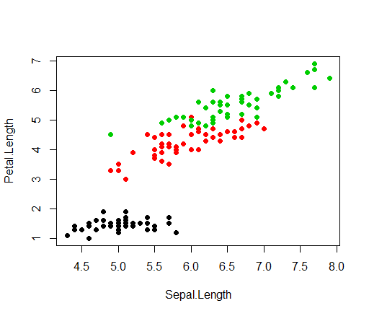
Are our errors independent?
Measurements taken from 3 different species
Broken assumption of linear model
Need to use mixed effect model
Increased statistical power

Slide 11
2 circumstances use linear mixed effects models
want to do variance components analysis because all explanatory variables are categorical random effects
have fixed effects, but also have pseudoreplication of one sort or another

Slide 12
Addressing pseudoreplication…
Repeated measures
E.g from the same individual over time
Pseudoreplication
Spatial – several chicks per nest, several nests per forest, several forests in study
Temporal – Data collected over multiple years
All together…
Several measures per chick, several chicks per nest, several nests pair, several pairs per forest, several forests per year.

Slide 13
Random factors…
“Allows each level of the random effect to be modelled separately, within an overall model structure”

Slide 14
Fixed or random effects?
Does the variable represent spatial or temporal autocorrelation, repeated measures or hierarchical structure?
YES = RANDOM
Time
Repeated measures from same transect
Location along a transect
Hierarchical structure of study design
NO = FIXED

Slide 15
Fixed or random effects?
Are the factor levels informative?
Do we want to know how they differ?
Do we want to estimate the effect size?
NO = RANDOM
Sample number
Site name
Plot A, B, C, D
YES = FIXED
Male, female
Treatment added, control
Juvenile, yearling, adult

Slide 16
Fixed or random effects?
Are levels a random sample of a larger “population”?
I.e we haven’t measured all possible categories
YES = RANDOM
Field 1, field 2, field 3 (in a much wider landscape)
France, Italy, Spain (there are a number of other countries that could have been sampled from)
NO = FIXED
Male, female
Dead, alive
There are no other measures we could make here…

Slide 17
Fixed or random effects?
Does the factor influence the variance of y, or the mean of y?
RANDOM = VARIANCE
FIXED = MEAN

Slide 18
Mixed effects models in R
library(lme4) or library(nlme)
compare fixed effects using maximum likelihood
no p values produced

Slide 19
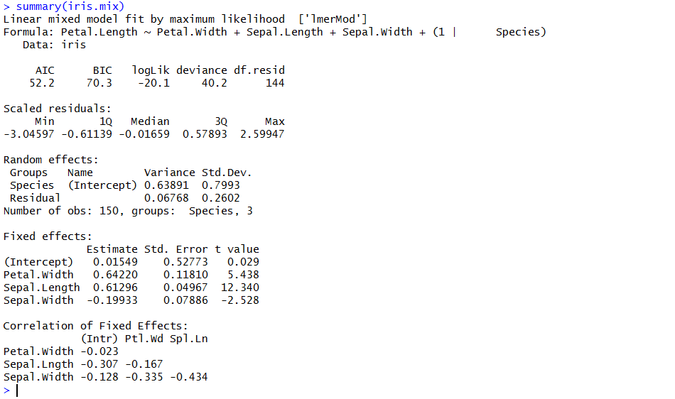
summary()

Slide 20
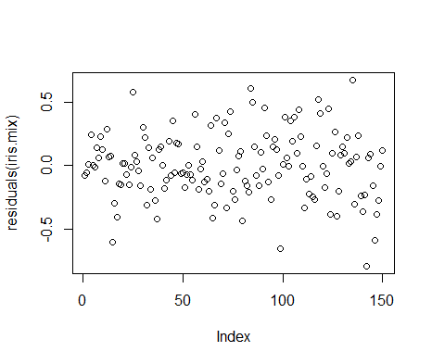
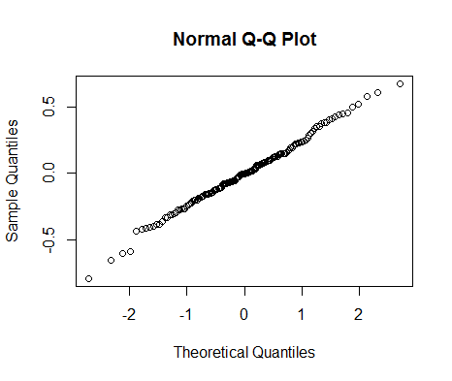
Residual Plots

Slide 21
Nested or crossed random effects
Use nested random effects for hierarchical data structure
Use crossed random effects for non-nested random effects
Use reduced maximum likelihood to compare random effects structures

Slide 22
Nested random effects
Load oats dataset -> data(oats, package='MASS')
Split plot experiment so define spatial structure
Variety is nested within block
e.g. Family/Genus/Species or County/Town/Household

Slide 23
Crossed random effects
Non-nested
Can run slower
(1|Batch) + (1|Variety)
Compare random effect structure using reduced maximum likelihood and AIC

Slide 24
Summary
Use lme:nlme or lmer:lme4
nlme will produce p values
use random effects to deal with broken assumptions of linear model - pseudoreplication
random effects can be crossed or nested

Slide 25
Resources
http://lme4.r-forge.r-project.org/slides/2009-07-07-Rennes/2Simple-4.pdf Presentation by the person who wrote lme4
glmm wiki - one of the most useful pages on the internet http://glmm.wikidot.com/faq

Slide 26
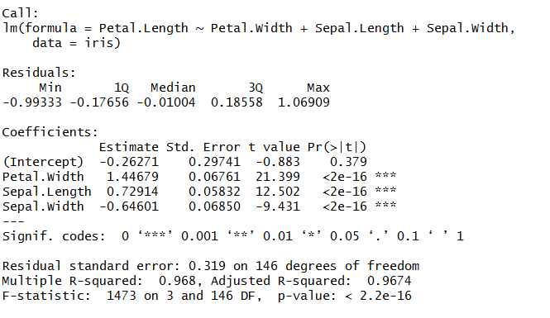
Next snippet
Getting to grips with model outputs

